Slide 1
Can we make data theft irrelevant? Foundations of Data-Centric Zero Trust
Prof. Emre Koksal, PhD – MIT EECS
Founder and CEO, Anchor
Professor of Computer Engineering, OSU
Notes:
Not a direct marketing talk. More like positioning and education.
Feedback:
Was the content interesting?
Was the content easy to consume?
Who do you think can benefit from the content?
Was it a good reflection of the area?
Parts to remove?
Parts to change?

Slide 2
Why is security fundamentally difficult?
Scope of a robust system: Is your system working as designed for 99% of all situations?
Scope of a secure system: Is your system working as designed under all situations?
Challenge: A statistically degenerate event must be treated as a typical event in secure system design.
Core problem: Traditional security cannot catch up with the growing attack surface as complexity grows.
Notes:
I will talk about the scope of security. It will be one of those rare cases in which I don’t use any slides; we will have a plain conversation.
It is important that we dedicate an episode to the scope of security, because there is a misconception on the coverage of secure system design: we think scope of security is about protection from external or internal attackers hacking our systems. While it is indeed important, by no means does it cover the complete picture. The problem is much broader: anytime the system you have designed does not operate as intended, that is a problem of security. So, the scope of security covers all situations leading to an undesirable/intended system operation. Much broader than one that is caused by an agent.
With that, secure system design consists of two stages: robust operation and broad security.
In robust operation, my design should take into account all situations that are of first order functional importance to the problem.
Nature throws us many situations and we have to make sure that our system is robust with respect to those exogenous factors, except for the degenerate cases.
This would cover a certain percentage, say 99%, of all situations under which your system will operate.
Once we are done, next stage is broad security. With broad security, we have to take into account all situations, namely 100%.
First question is why? Because in this stage, we assume there is an external attacker trying to mess up your system. They will try it all!
The second question is why would that 1% or 0.1% of situations make a difference in my system design? It makes a huge difference, because the cases that you considered as statistically degenerate in robust design are typical in this phase. But why? Because the external intelligent agent makes the rules.
In the next episode, I will continue talking about IT infrastructure (the system that empowers us to access data no matter where it lies and no matter where we are) and explain why traditional security cannot address the problems that we are facing in the light of secure system design paradigm.
There is an incredible amount of difference between design for 99% and design for 100%.
Why is it 100% for security? Because the situations are dictated and exploited by an attacker. The attacker is highly capable of finding the 1%. Technically this is referred to as the minimax problem. Max utility even under the minimum/worst of the situations. Very difficult, and much worse than ignoring 1% of the corner cases.
Agents are not natural, they are unnatural.
Let us visually understand the problem this is causing.
All paths combined. Authenticate → packetize → transport
Paths taking users to data. Grows with complexity. Contrast physical situation with networked setting.

Slide 3
Back to basics
threat
threat
asset
exploit
vulnerability
threat
Risk: Threats + vulnerabilities on your asset
This talk: what’s the nature of data risk and can we mitigate it?
Notes:
Two components, threat+vulnerability. Threat: exogenous, vulnerability: controlling them is under your control to some extent.
Risk: undesired event and likelihood pair. Event part of risk is the attack turning into exploit. High risk means: high likelihood of the undesired event.
The question of how long can we go until attack becomes successful is one of risk. Need a framework for measuring and evaluating these events.

Slide 4

History
data $→$ disk $→$ application
Notes:
You literally carried your data with you.
Data stored at a disk at all times. Protection meant physical.

Slide 5
Your most valuable asset: data
Information System: Combination of protocols and channels connecting you to your data.
Layers
user
data
physical layer
network
transport
access
exploit
threat
Channels
Attack surface: Set of possible vulnerabilities.
Grows with system complexity!
Next: Traditional approach to address data risk – architecture and philosophy
Notes:
Risk: undesired event and likelihood pair. Event part of risk is the attack turning into exploit. High risk means: high likelihood of the undesired event.
The question of how long can we go until attack becomes successful is one of risk. Need a framework for measuring and evaluating these events.
Risk being my data being taken, authentication is a measure to reduce the attack surface. Important question is, authentication, while being critical, can change the way users interact with data. We have to be cognizant of that while we add solutions. There seems to be a tradeoff. One extreme is pushing everyone to carry a disk, eliminating all virtual vulnerabilities, but at the same time adding significant friction to the way we like to operate. The other extreme is to eliminate auth completely so zero friction, but that would mean my data is exposed. The usability of a solution is highly related to where in this tradeoff curve a solution lies.

Slide 6
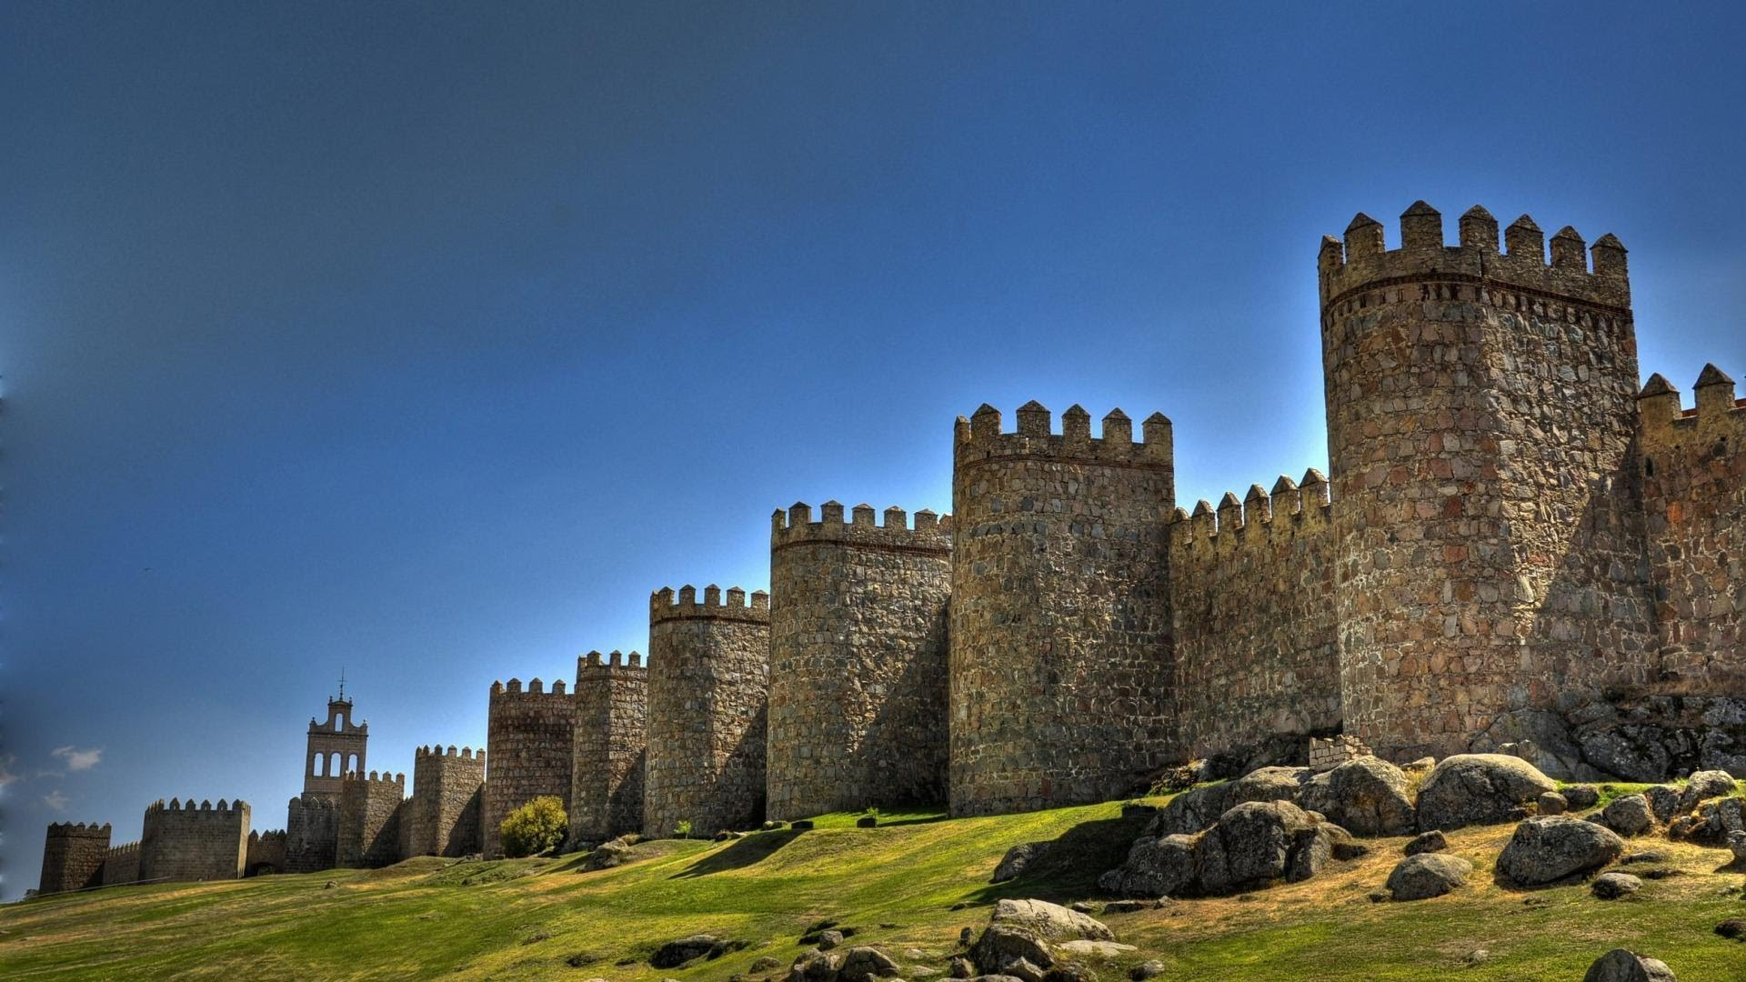
Traditional security is perimeter-centric
Castle mentality
Manage the activity around data
Data needs to be in the castle for protection
Notes:
From an architecture perspective

Slide 7



Traditional security is about shrinking the attack surface
Blocked
channels
Port 19
Exploit the vulnerabilities
(e.g., Bof, impersonation, etc.)
Port 123
Port 161
Attack surface is
shrunk
Firewall
Traditionally, security focused on shrinking the attack surface.
Each approach focuses on eliminating one vulnerability at a time.
Issue #1: Attack surfaces are evergrowing!
Issue #2: Notorious utility-security tradeoff.
Notes:
From a philosophical perspective
Let’s look at another example to solidify our understanding. Firewalls are about filtering and blocking ports (oversimplification). Attack surface is indeed shrunk. This is typically how traditional security looks at things. Eliminating vulnerabilities by blocking networks, devices and people. Even if you are eliminating vulnerabilities, the potential threats and vulnerabilities keep growing. Is it an issue really?

Slide 8
Why things are actually worse than they seem to be
attempts
unsuccessful
.
.
.
exploit
attempts
Surface
With a sequence of exploit attempts, unsuccessful attack probability decays geometrically.
$⟹$ risk grows exponentially.
Notes:
We ignored the repeated nature of these experiments. The probabilities we’ve conveyed were for one time attacks. But, there is a time dimension to the problem.
We used a probabilistic model to study the exploit attempts and their success. To convey the model better, I have used an analogy involving the tosses of fair coins, making tails the unwanted events. The point we made was, similar to a sequence of tosses and seeing no tails in these tosses, when we have a large attack surface (and hence a large sequence of possible exploits), the probability of no success in these attempts decay quite fast.
Today, we will follow the same line of argument for the sequence of attacks. To be more precise, attack surface is a spatial quantity in our model. Exploits cover a space across the surface. Today, we will make the same argument for the temporal dimension. Namely, attacks do not occur just one pass across the space. They occur in time in a repeated fashion as well.
The implication is not different at all, if anything they are worse. Now suppose the second wave of attacks come. Of course not all of them come simultaneously like in this figure, they may arrive in different sequence. But, the important thing here is that, they are repetitive. And with each repetition, the probability of successful exploit increases.
Think of your defenses as an offensive line in football. You are subjected to continual blitzes. In space: it suffices for one guard to fail. But they may not, in a given blitz. Not take ten of them in succession: all it takes is one guard fails in any one of the attempts.

Slide 9
Perimeter-centric security is destined to fail
10-user organization
Ever-growing risk
Your data is common commodity
Average value at risk is identical to the whole dollar value of your data!
You can forget about cyber insurance
Compliance is extremely difficult
Likelihood of your organization compromised
Efforts to close the gap
amplify the friction between business and security
Number of attacks per month
Notes:
The number of attackers as

Slide 10
A high-level look at the layers in security
network
network
security
application
application
security
storage
data
hardware
security
Defense in depth – layering security
Layered detection and mitigation
Control the paths between users and data
Reduce the attack surface
The need for rigorous defense in depth is due to perimeter-centric mentality
Notes:
Traditional IT → control

Slide 11
What about zero trust?
Perimeter-centric
Zero-trust
network
network
no trust
no trust
trust
no trust
data
data
NSA strongly advocates the zero-trust model
Notes:
Change in philosophy without a fundamental change in the architecture. Indeed, zero trust is typically a combination of existing tools in a slightly different way.

Slide 12
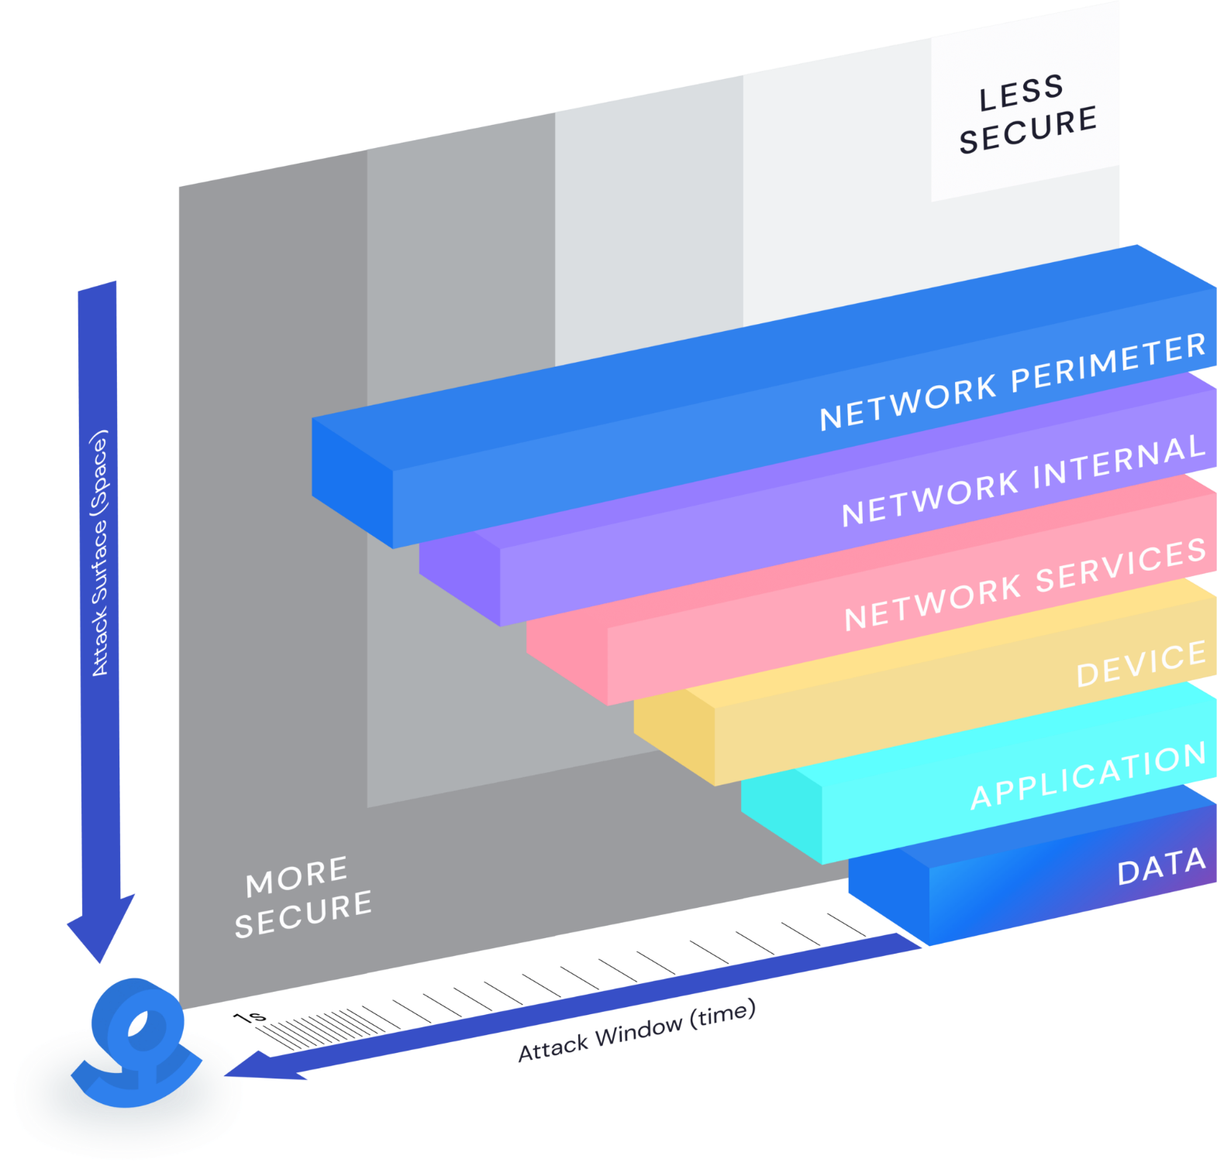
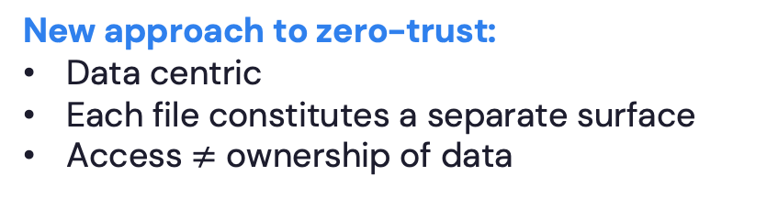
Zero-trust at what layer?
Traditional security:
Perimeter-centric
Attack surface and window – large
Traditional zero-trust:
No perimeter
Each request for access is evaluated
Access=ownership of data
New approach to zero-trust:
Data centric
Each file constitutes a separate surface
Access $≠$ ownership of data
Notes:
If you think of the attack surface as a combination of the temporal dimension (time) combined with a spatial dimension (set of vulnerabilities), making data self protecting is a significant improvement in the attack surface. Changes the economics of an attack.

Slide 13


What if we make data protect itself?
No notion of
securing perimeter
network
application
storage
Making data its own security boundary
data
data
Security travels with data
security
boundary
data
Data theft is irrelevant
Network breach $≠$ Data loss
Notes:
Zero trust: your assets are stolen are compromised and still you need to be able to protect them. Every request is untrusted by default --> validate separately. Traditionally pushed to the network/application. This idea is pushing it a step deeper into data.

Slide 14
With data-centric zero-trust, management is simple
No notion of
securing perimeter
network
application
storage
Making data its own security boundary
data
data
Perimeter centric
IT managed
Setting the perimeter
Perimeter is the attack surface
Data centric
User managed
Focus on files/folders
Universal across applications and stores
Network breach does not equate data breach
Notes:
Makes a huge difference in terms of management complexity. Data groups and classes have semantics that would be better managed by business users – not

Slide 15
Data-centric zero trust
Access
Authentication
Authorization
Visibility
How are we going to combine the above?
Notes:
The whole idea is about giving access, but not ownership.

Slide 16
How can we do dynamic authorization?
file
context
encrypted
plaintext
inside
outside
Idea: Entangle authentication with file encryption
state of a file
Always encrypted out of context
Access only within context
New paradigm in defense in depth: entangled layers of security
Notes:
It all comes together.

Slide 17
Impact
Data theft is irrelevant - Network breach does not lead to data breach
Focus not on blocking the activity – Surface is lowered to the data-layer
Universal and basic – Mentality not around catching up with a specific attack
Potential challenges – Availability of data wherever you want it and quickly

Slide 18
What we learned
Recap
Scope of security and traditional approaches
Focus on surface and risk scaling
Zero-trust down to a file
Main conclusions
Bad news: In modern IT systems, the attack vectors grow in type and frequency. As the cyber risk (measured in attack success probability) approaches exponentially with the volume of the attack vectors, with classical solutions, it is a matter of time your data is common commodity.
Good news: Modern approaches eliminate the expected value at risk due to external and internal mechanisms combined.

Slide 19

Control the Data.
Free the People.

Slide 20
Demo

